Slide 1
Flow of Control:
Loops
Creative Commons Attribution-NonCommercial-ShareAlike 3.0 Unported License. http://creativecommons.org/licenses/by-nc-sa/3.0/
Written by Rachel J. Morris, last updated 2015-01-14

Slide 2

Stay a-while and listen...
Creative Commons Attribution-NonCommercial-ShareAlike 3.0 Unported License. http://creativecommons.org/licenses/by-nc-sa/3.0/
Written by Rachel J. Morris, last updated 2015-01-14

Slide 3
While Loops
Being able to loop through a task multiple times is part of what makes software so useful.
Ever had to go through a bunch of documents and add a tiny thing, over and over and over?
Computers handle repetitive tasks for us.

Slide 4
While Loops
Loops can also be used to section off portions of our program -
Without loops, a program would go from point A to point B and then quit.
But we can tell the program,
“While the user has not quit”,
Keep running.

Slide 5
While Loops
SAMPLE PROGRAM
OPTIONS
1. Do task A
2. Do task B
3. Quit
>> 1
((TASK A))
OPTIONS
1. Do task A
2. Do task B
3. Quit
>> 3
GOOD BYE
Program Init
Main Menu
Task A
Exit
Task B
Program
clean up

Slide 6
While Loops
We use Boolean Expressions with while loops, to specify how it should keep looping. Once that expression is false, it will break out of the loop.
Conditional | C++
Equal to | ( var1 == var2 )
Not equal to | ( var1 != var2 )
Less than | ( var1 < var2 )
Less than or equal to | ( var1 <= var2 )
Greater than | ( var1 > var2 )
Greater than or equal to | ( var1 >= var2 )
True | ( var1 == true )
True, shorthand | ( var1 )
False | ( var1 == false )
False, shorthand | ( !var1 )

Slide 7
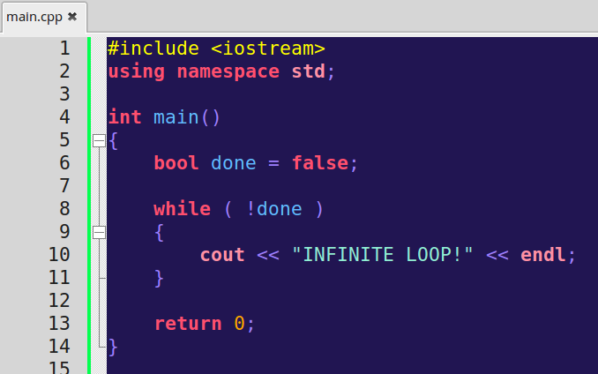
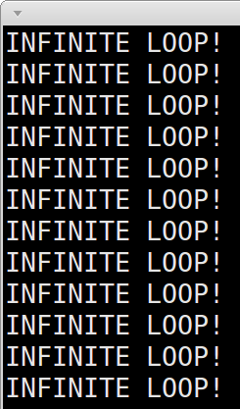
While Loops
Because a loop will keep looping until the given criteria is false, it can be very easy to write an infinite loop.
Somewhere within the while loop, you will need to add logic that will make the criteria false, or it will loop forever.
“while not done”

Slide 8
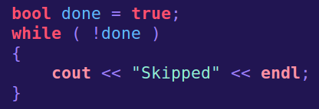
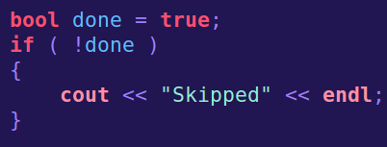

While Loops
Like an if statement, if that criteria is false to begin with, the internal code block will be skipped.
But if the criteria is true, the if statement will only execute the internal code once, while the while loop will continue looping through the internal code.

Slide 9
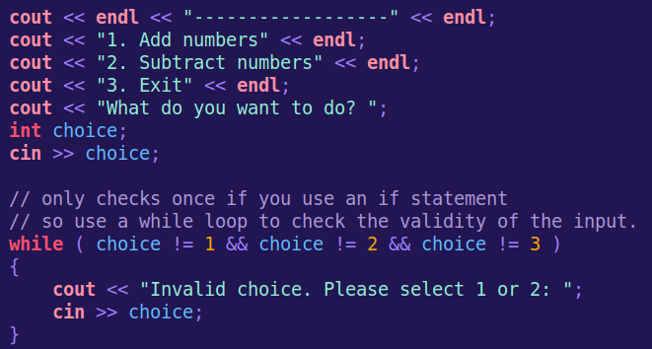
While Loops
Application 1: Checking for valid input
You can use a while loop to make sure the user inputted a valid option.
A while loop is best here, because an if statement would only check once.
If the user entered an invalid option on the 2nd try, an if statement wouldn't check it again. A while loop keeps looping until the user inputs a valid option.

Slide 10
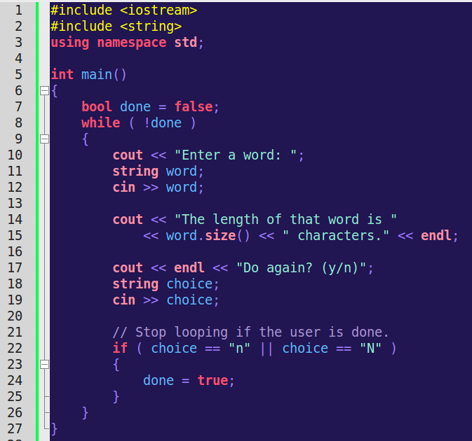
While Loops
Application 2: Keep a program running
We can keep a program running until the user quits with a simple boolean.
(Just make sure that you do set “done” to false at some point!)

Slide 11
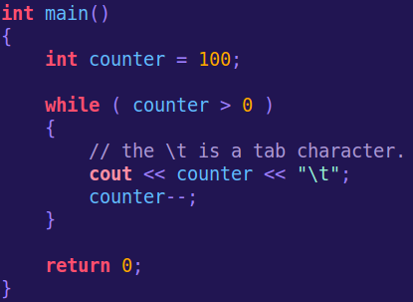
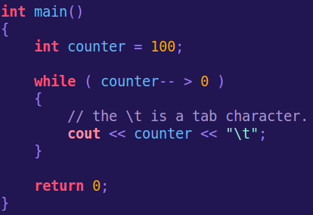
While Loops
Application 3: Count
You can also use a while loop to do a certain task a specific amount of times.

Slide 12
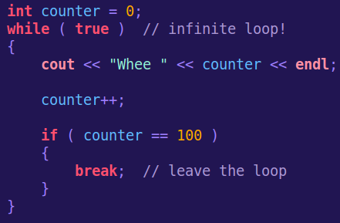
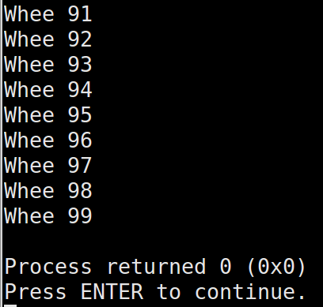
While Loops
You can also use the break; command to break out of a while loop, rather than having to set its criteria to false.

Slide 13
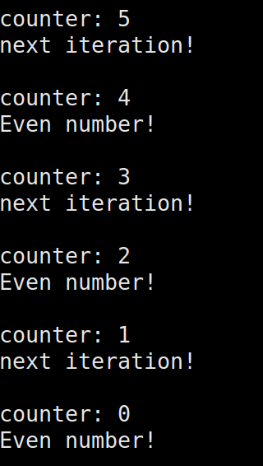
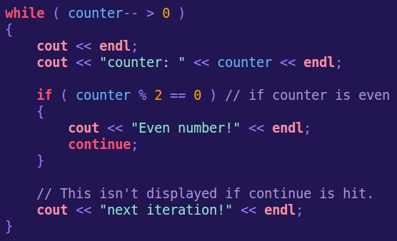
While Loops
There is also the continue keyword – it will skip the rest of the loop on the current iteration that you are on, but continue looping overall.

Slide 14
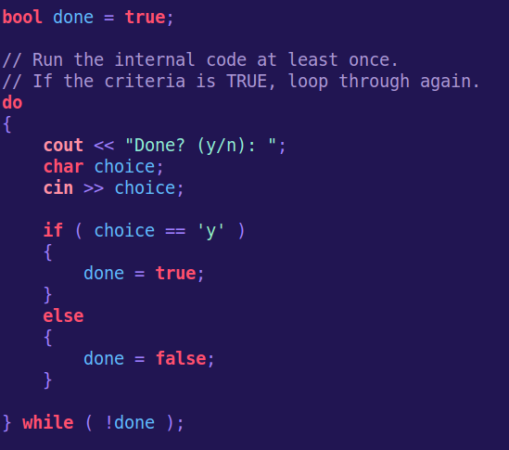
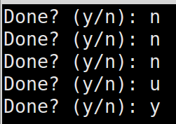
Do While Loops
A do while loop is similar to a while loop, except that a do while loop will always be executed at least once.
After the first run through the loop, if the criteria is false, it will exit the loop.
“while not done”

Slide 15
For Loops
A for loop is a type of loop that is best suited for counting.
You specify a begin point, end point, and increment (or decrement) amount, and the for loop will loop for the appropriate amount of time.
Starting point
Loop until
Increment Amount
for ( int i = 0; i <= 10; i++ )
{
cout << i << endl;
}
“while not done”

Slide 16
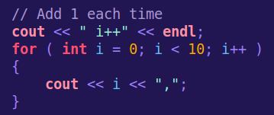

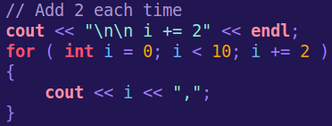

For Loops
You can use i++ or ++i to add 1 to i each time through the loop,
Or you can use a += to add a different amount
“while not done”
But you don't have to stick with just adding...

Slide 17
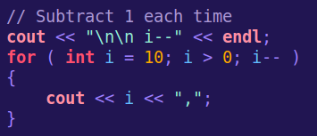


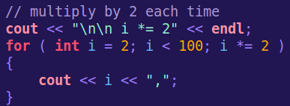
For Loops
You can also use other math statements, such as
-= (subtract by), *= (multiply by), and /= (divide by)
“while not done”

Slide 18
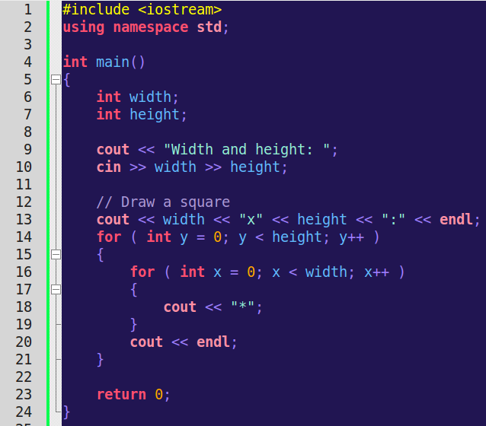
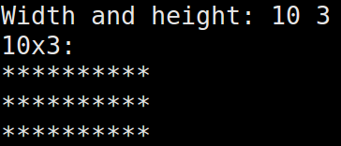
Nested Loops
And like if statements, you can also nest loops within loops.
You can also nest if statements within loops, and vice versa.
“while not done”

Slide 19

Got a lot of loops to make now!

